Slide 1
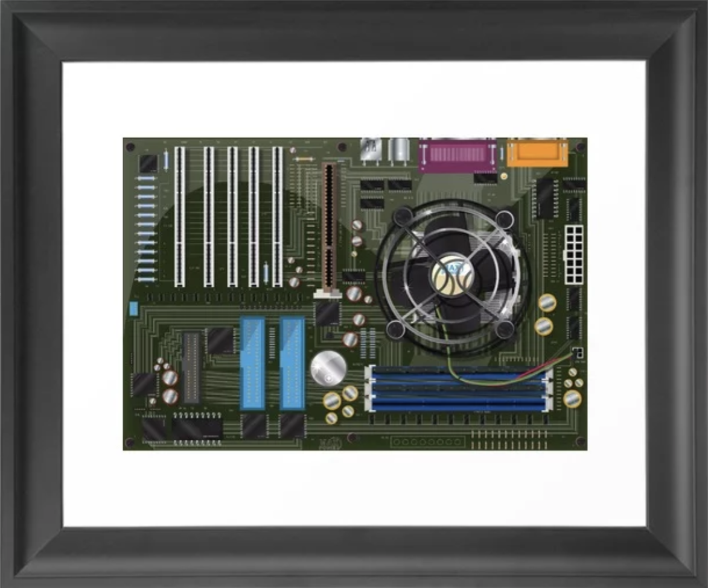
The art of the technical
Katie Roberts

Slide 2
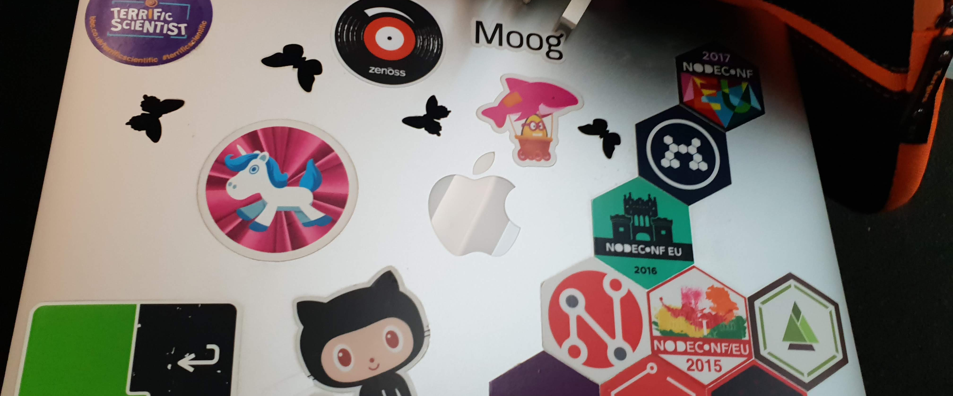
Who am I?
Notes:
Engineering Manger at the BBC
15 years experience in the software development
sectors over the years (Education, advertising, games, media)
platforms (TV, mobile app, web, API backend)
I present at conferences
I am a unicorn

Slide 3
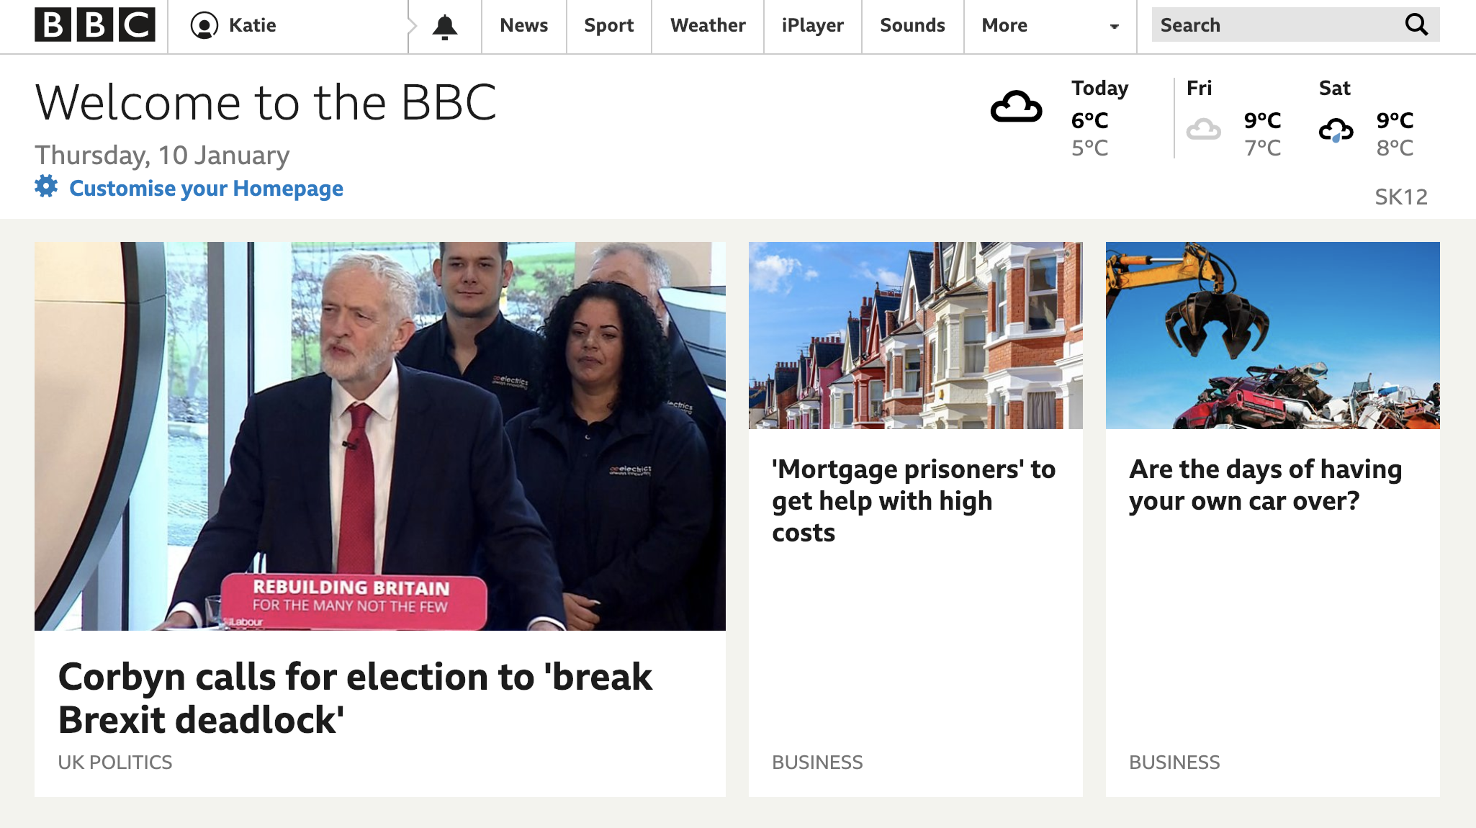
What do I do?
Notes:
Engineering Manager – does
Products - Homepage, Search, navigation
Search powers search across the BBC estate including iPlayer
Navigation not just the visual – also
the delivery mechanism of shared services to all bbc pages
such as analytics reporting, cookie management
Homepage – over 1 billion clicks last year

Slide 4
Why am I here today?
“…Help bust the myth that tech isn’t a creative industry.”
Notes:
Tech is for Creative People – help bust the myth that tech isn’t a creative industry (or that creative people can’t do tech). This is an opportunity to share examples and tell stories of how creativity complements all the other skills used in tech jobs

Slide 5
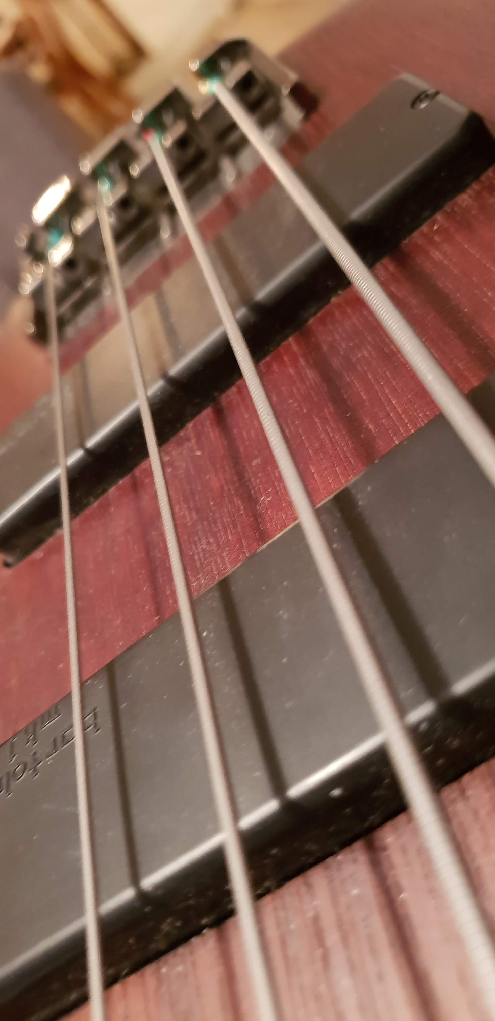
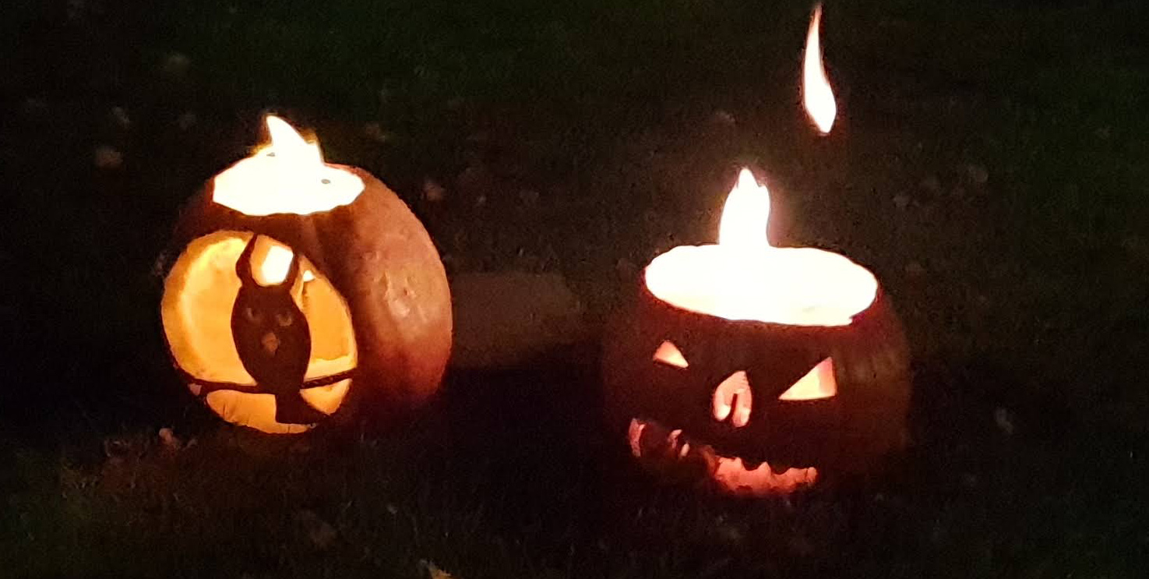

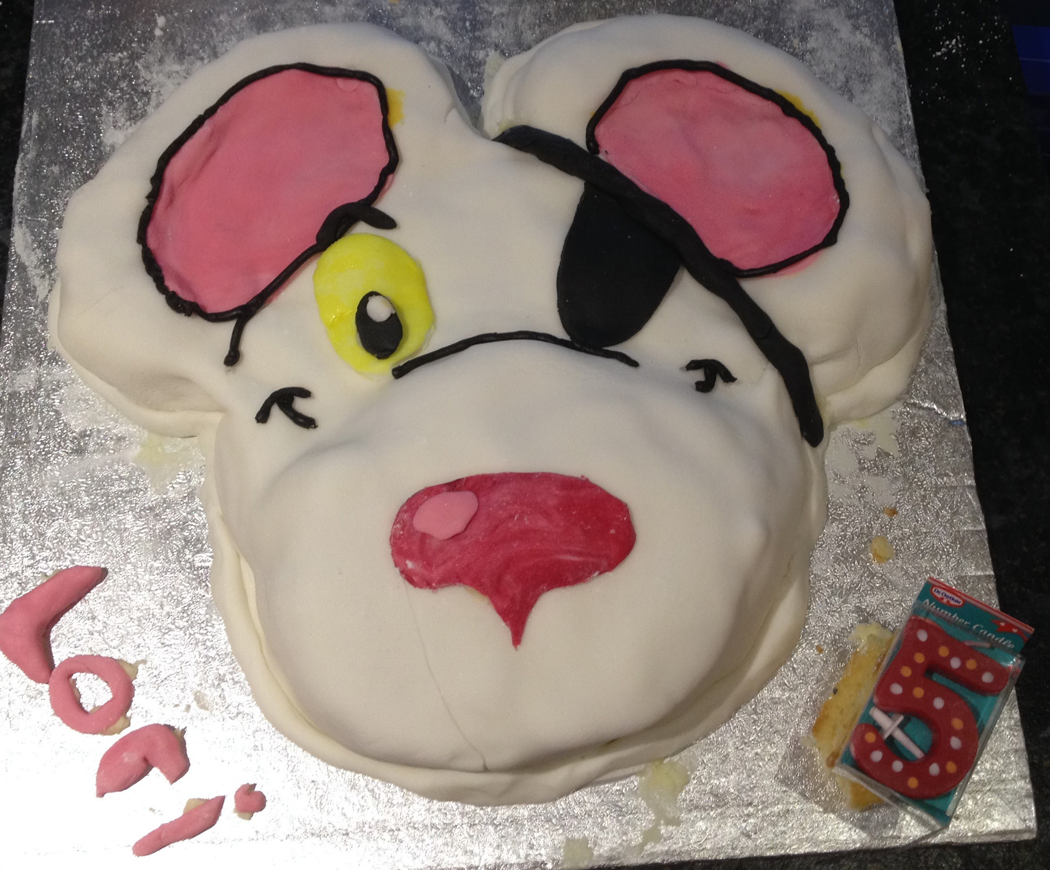
Notes:
Consider myself a creative person
Video artist – created visuals for clubs in South London
Also a mother – any one with young kids knows you need a certain amount of creativity to keep them distracted
But I also work in tech

Slide 6
How did I end up in a career in tech?
Notes:
Why choice of career?

Slide 7

The Real world
Notes:
Degree in Psychology – why not computer science??
Research assistant job, then went on to be an audio visual specialist setting up conferences for banks
Creatively stifled
2003 and signed up to do an MA in Design for interactive media

Slide 8
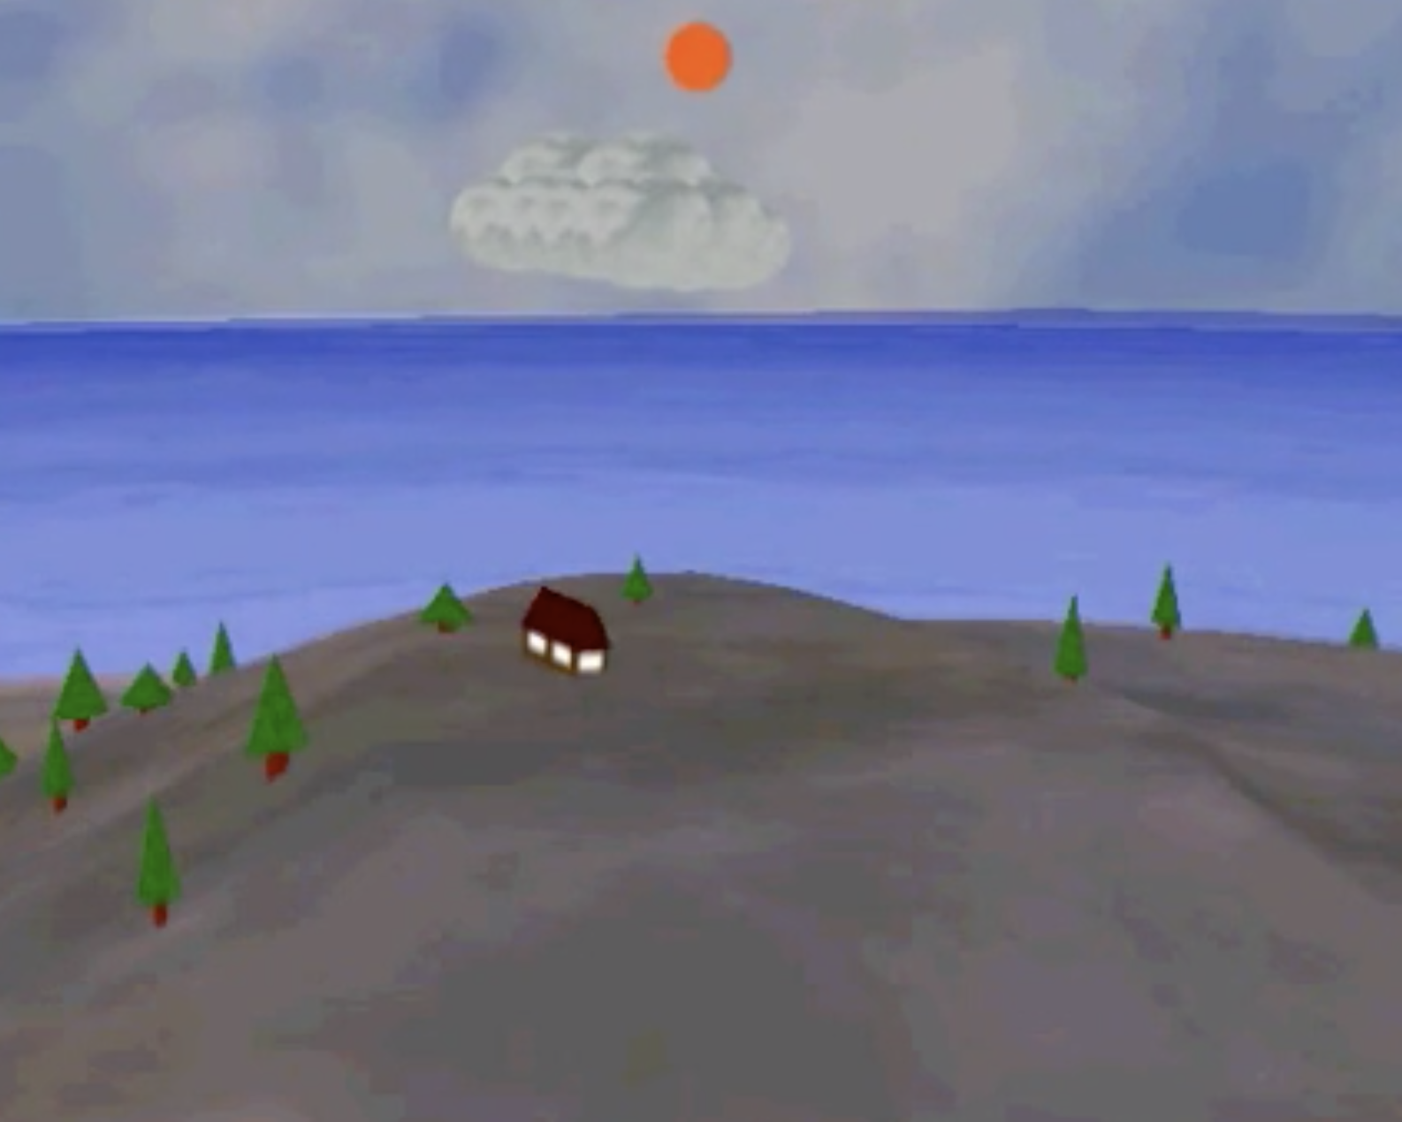
My Masters was supposed to make me better at photoshop
Instead it taught me to
build worlds
Notes:
What this is – screen shot from my final degree project
- I built a world
I was able to turn my abstract ideas into reality using code
And I was able to take an audience with me
job in design after ☹ –I was just moving pixels around – it felt very 2 dimensional
It was the code I loved

Slide 9
And after that …
I was hooked
Notes:
(Lingo as a gateway coding drug)
:heart: code
- was able to build interactivity into my images in a way I hadn't before
- Audience experience / multiple view points
And I was able to completely control how that experience was delivered to them
I found a proper tech job with proper tech problems and I became a proper developer

Slide 10
What made developing different?
Coding === problem solving
Notes:
I need to take this piece of data and present it to the audience – how am I going to do that?

Slide 11
What made developing different?
Problem solving === Creativity
Notes:
And coding is problem solving –
You start by solving the simple things (how to put a box on a screen)
Then you build on that (how to make it interactive)
And then you keep going – you paint with logic, until you create the impossible, the unimaginable, and the amazing

Slide 12
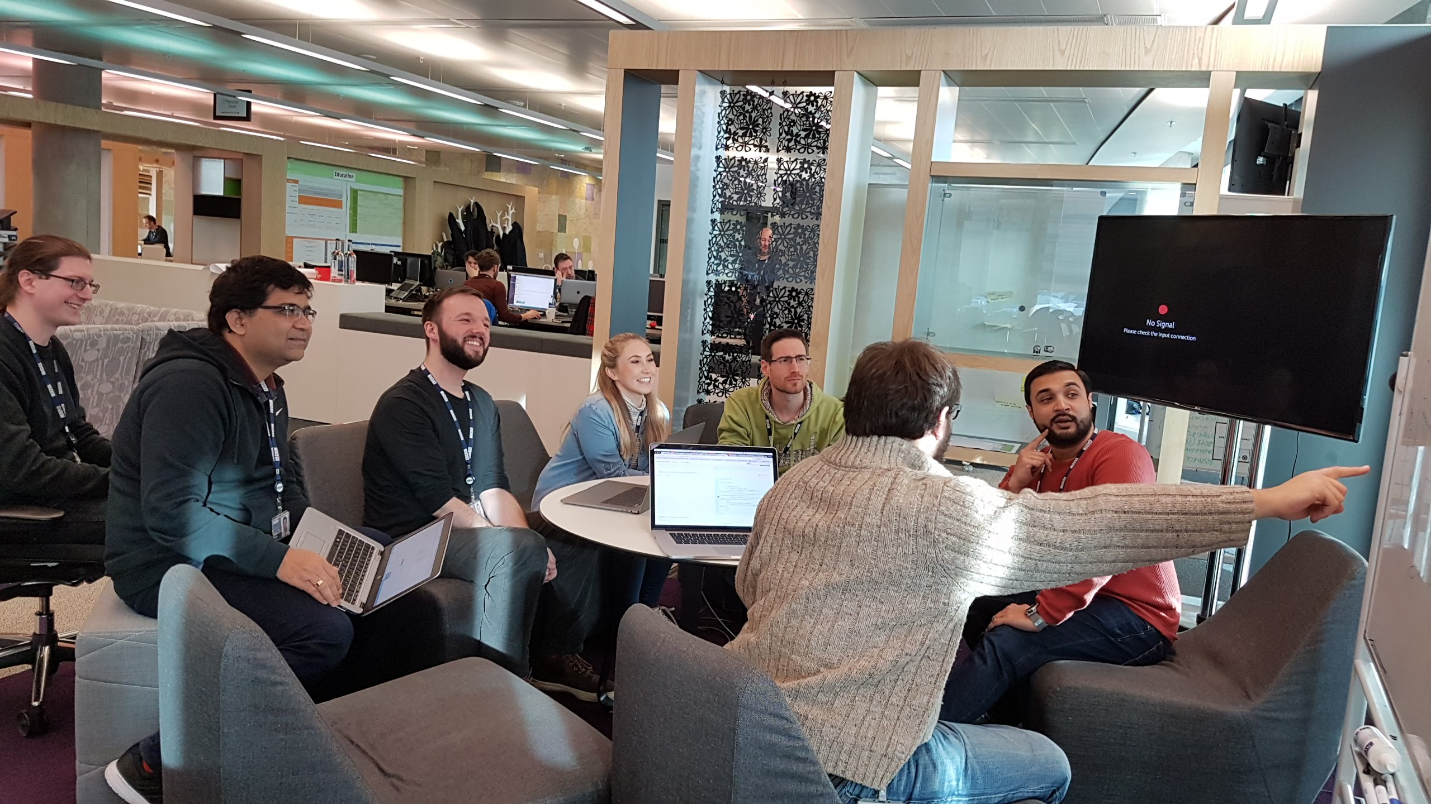
We don’t solve problems alone
Notes:
In reality craetive teams –
How are we going to solve that together

Slide 13
What can coding do?
Code lets you experiment
Notes:
Kids are creative – they like to experiment – son got a chemistry set for Christmas ….

Slide 14

Notes:
Microbits – every year 7 in the country 2015 – programmable
IoT projects – microbits
Kids have these – teaches programming skills using scratch, js or py
Light display, buttons, radio and bluetooth antenna, compass and “edge connector for accessories”

Slide 15
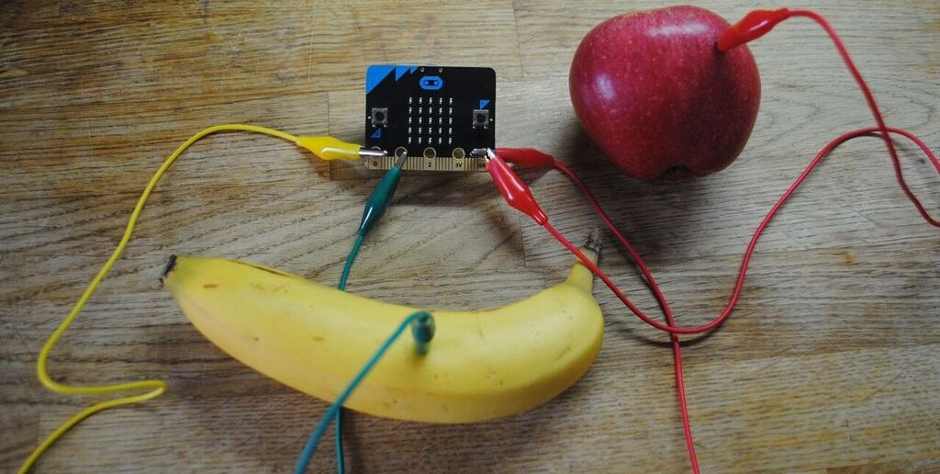
Notes:
This is a fruit theremin – using a bbc microbit
The code does not judge – it just lets you express yourself in which ever way you want to

Slide 16
What can coding do?
Code lets you create
Notes:
Not just thermins either

Slide 17
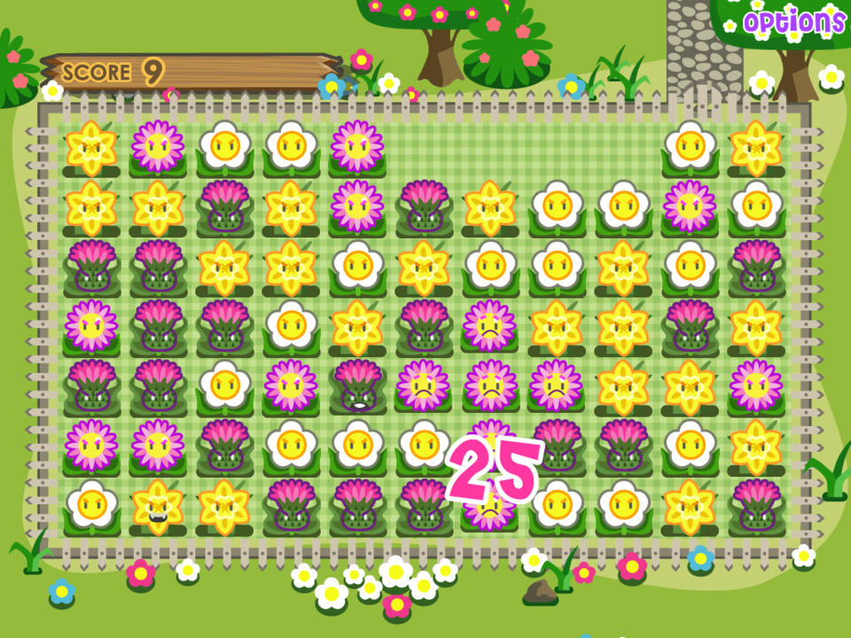
Notes:
Every game on your mobile has code behind it, and every game has creative solutions to make it work
Wee Wee Kitty
Visual elements
Logic behind
Not everything you see on screen will have an obvious requirement for creative thought

Slide 18
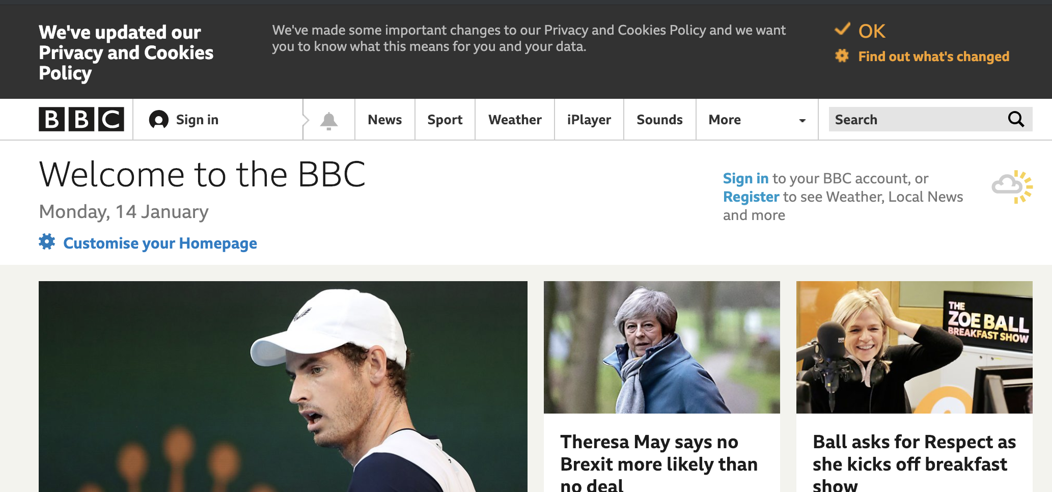
Notes:
Take the Cookie Banner here
Legal requirement – GDPR (General Data Protection Regulation)

Slide 19
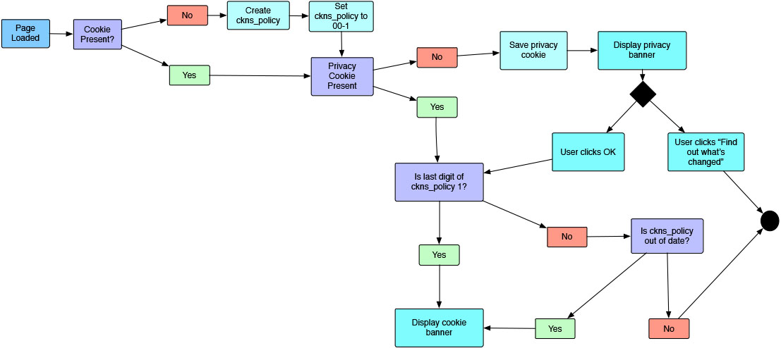
Notes:
So the development team had to use their creative abilities to work out how and when to show the banner.

Slide 20
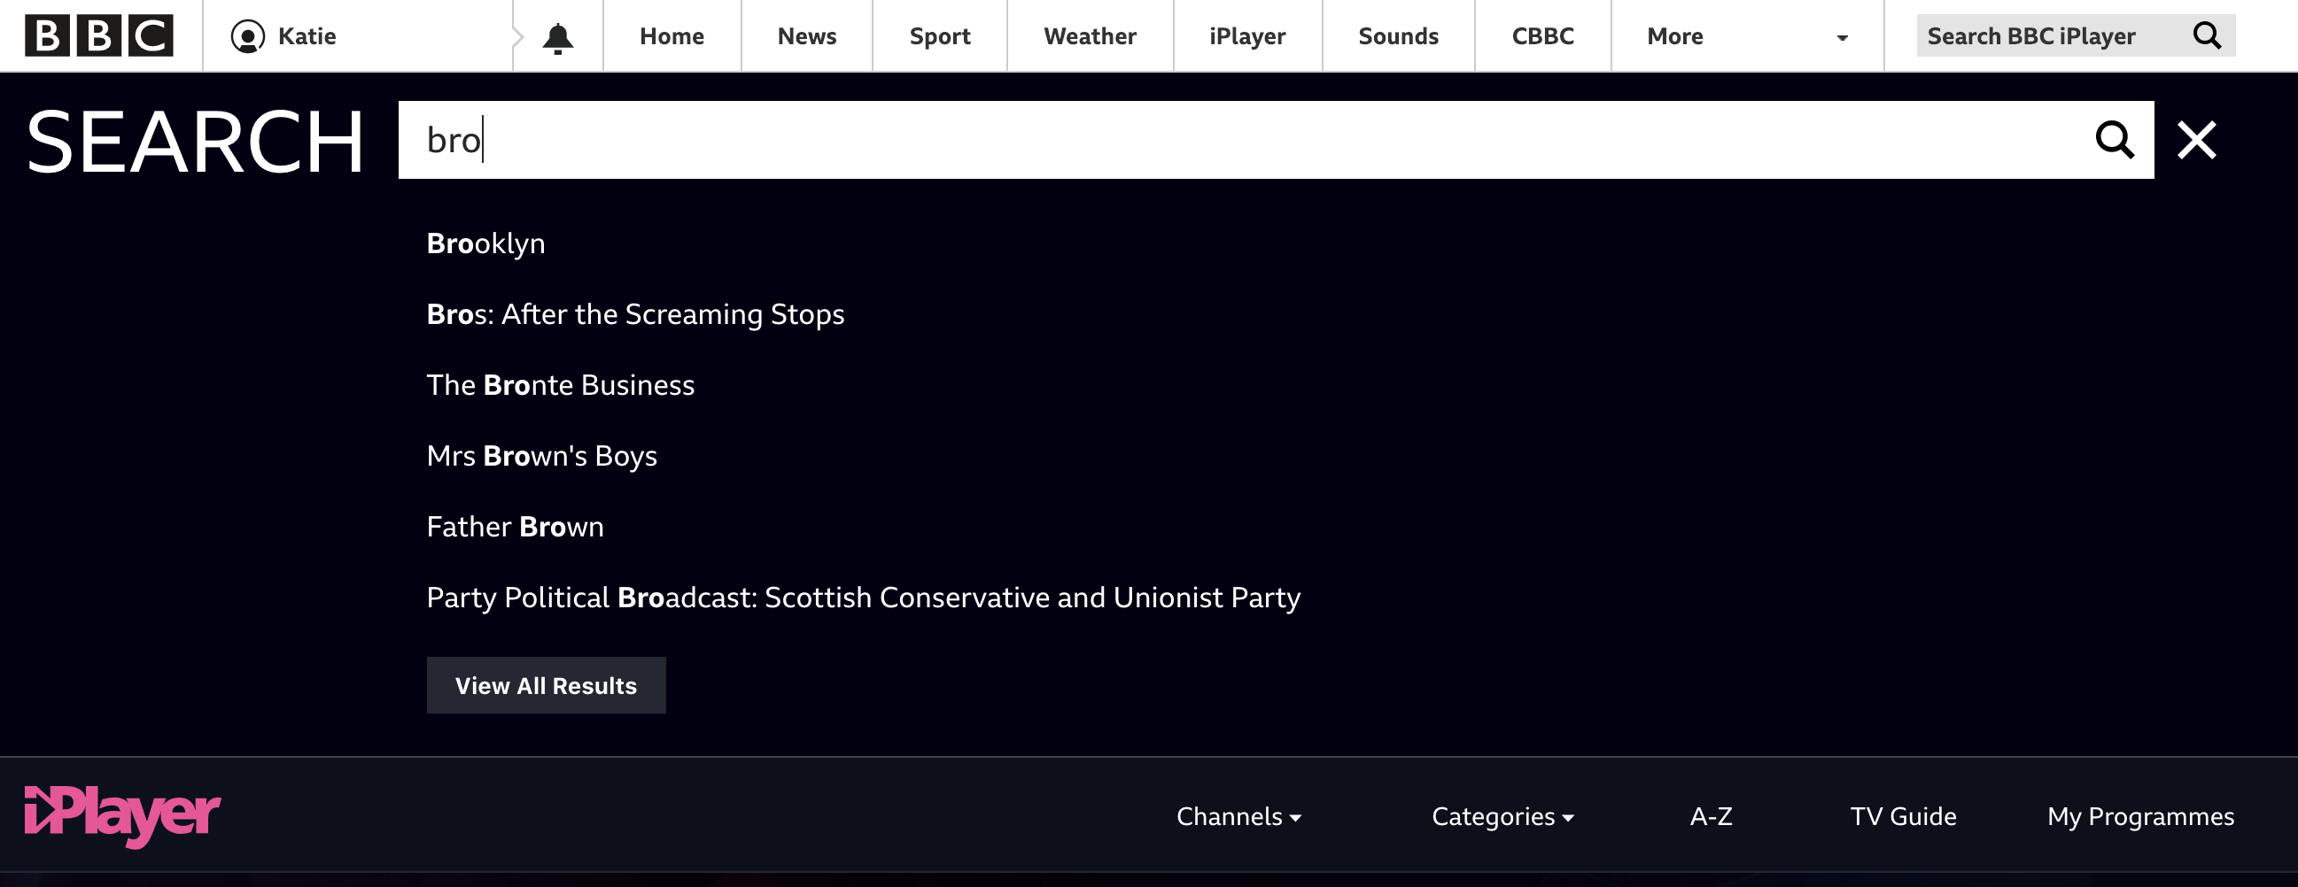
Notes:
You may have searched in the past…

Slide 21
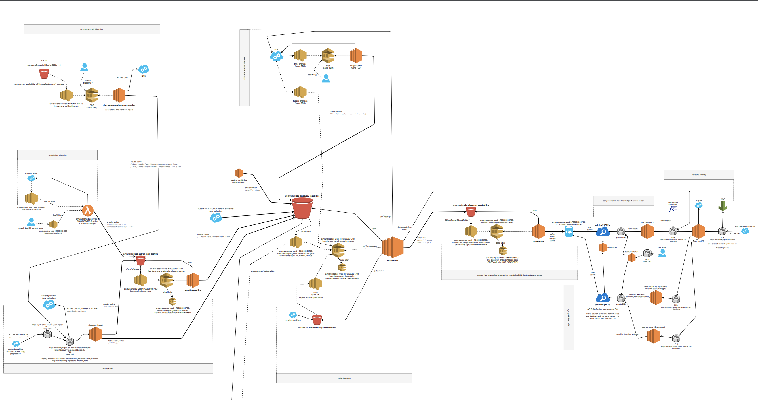
Notes:
An amazingly complex system that gathers data and allows users to traverse across it with search terms
Or it could be something that provides the user with a better

Slide 22
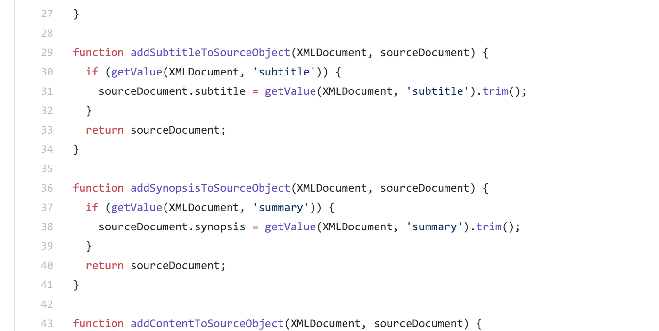
Notes:
Beauty of the code itself
Zen like state of writing lines of logic

Slide 23
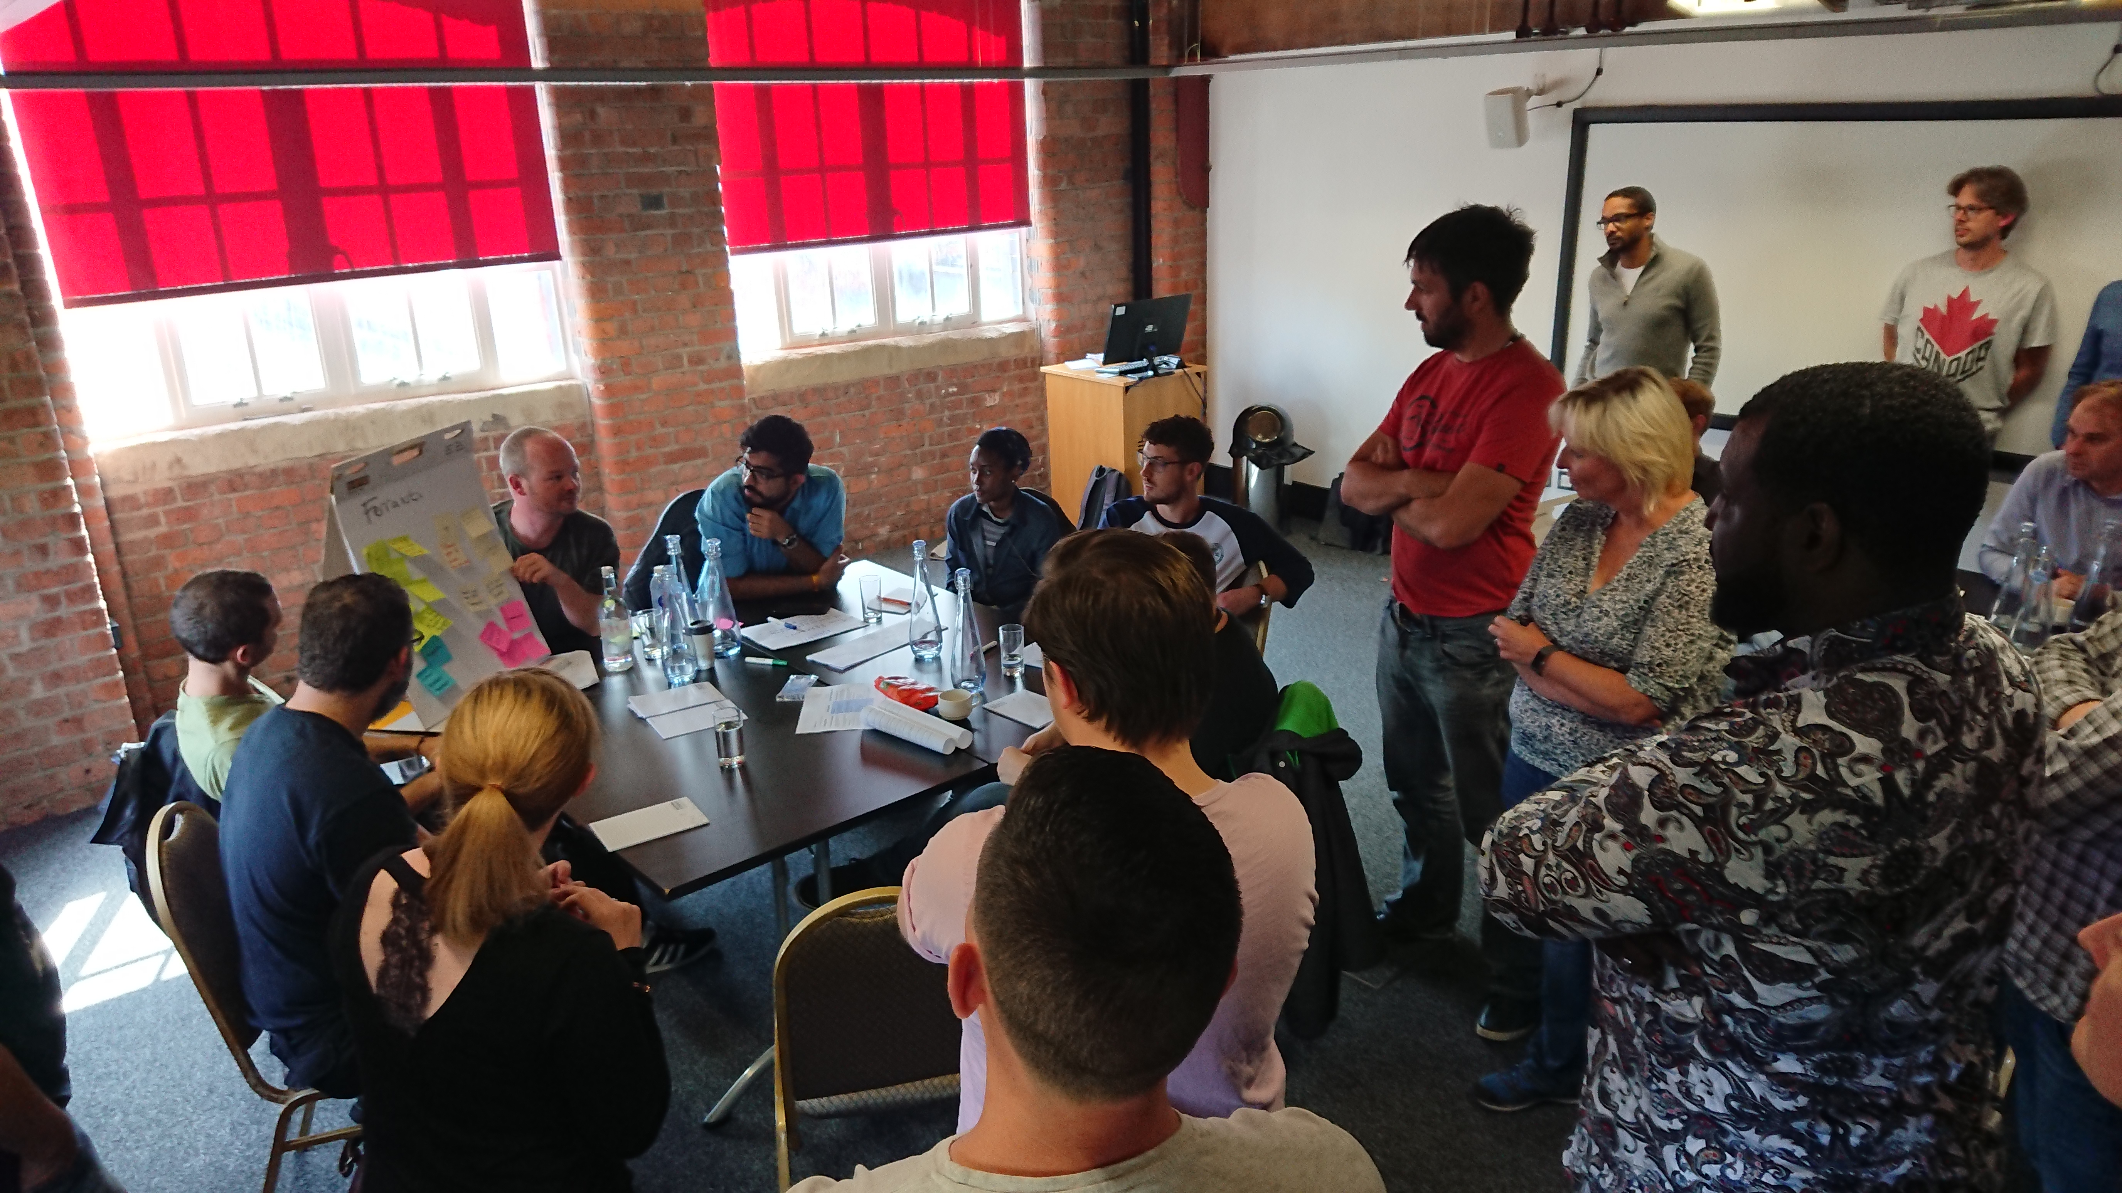
Notes:
Management – has it’s own zen – the zen of the teams

Slide 24
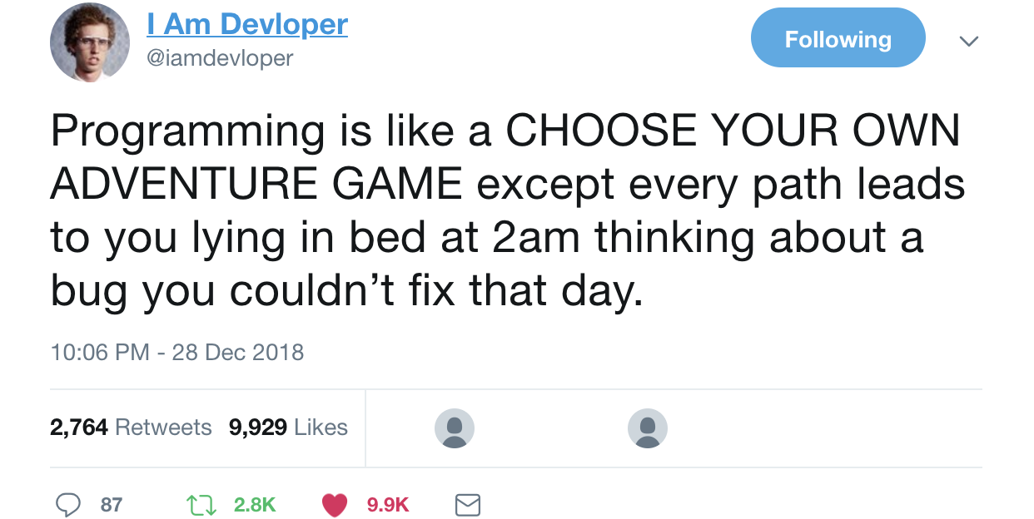
Notes:
passionate about something – and you are connected with trying to fix it.
Your creative brain is engaged and looking for solutions
But when you beat that bug you feel unstoppable

Slide 25
Any Questions?
@moogster31

